Slide 1


Portfolio Creator
Student Name:
Ayham Sunbol
Abdullah Mohammed amin Khojah
Submitted to:
[Dr/EMAD]

Slide 2


Project Description:
Portfolio Creator is a simple and user-friendly web application that allows users to build their own professional portfolio without any technical skills.
The system includes authentication, data storage, editing tools, and a live preview feature.
Users can manage their personal information, skills, projects, and contact details — then generate a complete portfolio page with a shareable QR code.
Built using HTML, CSS, Flask, SQLite3, and bcrypt for secure password hashing.

Slide 3

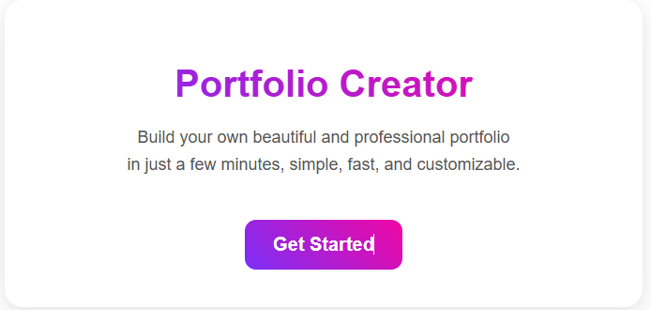
Purpose: Entry page of the system.
Description:
Simple, clean introduction to the application with a “Get Started” button. Leads users to the login page.

Slide 4

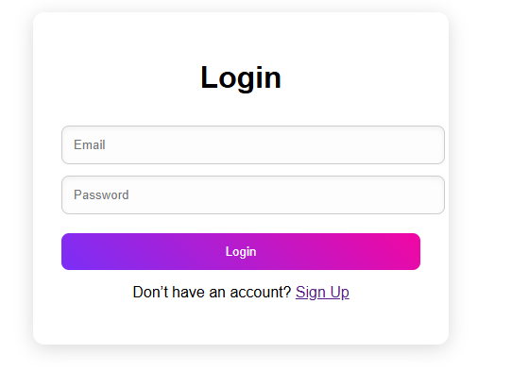
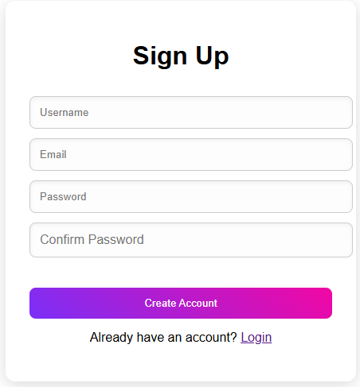

Purpose: Authenticate users securely.
Description:
Users enter email and password. The system verifies the hashed password using bcrypt.
If successful → navigates to Home Page.
Purpose: Create a new account.
Description:
User enters username, email, password, confirm password.
Includes validation + password hashing.
After signup, the user is redirected to the Home Page automatically.

Slide 5
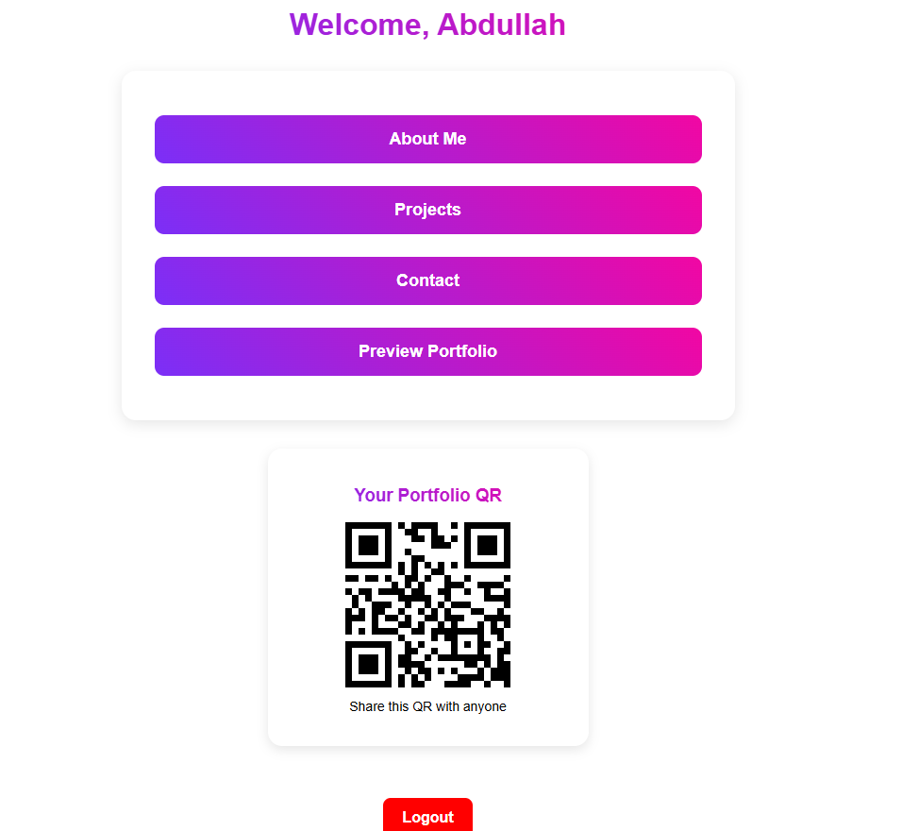
Purpose: Main dashboard.
Description:
Displays a welcome message with the user’s name and navigation buttons:
About Me
Projects
Contact
Preview Portfolio
Also shows a QR code users can share to provide quick access to their online portfolio.

Slide 6
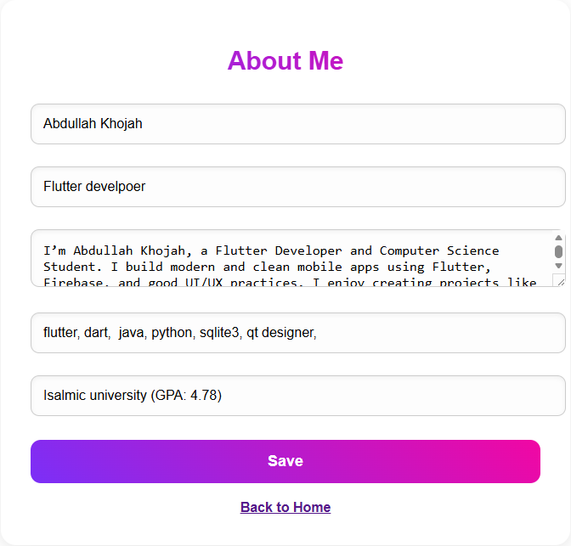
Purpose: Add/Edit personal information.
Description:
User fills in:
Name
Role
Bio
Skills
Education
Data is saved to SQLite and shown in the preview page.

Slide 7
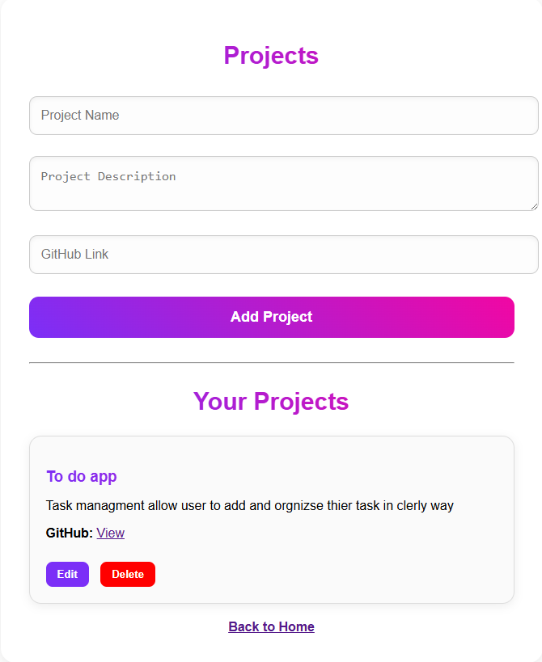
Purpose: Manage user projects.
Description:
Users can:
Add new projects
Edit existing projects
Delete projects
Each project includes project name, description, and GitHub link.

Slide 8
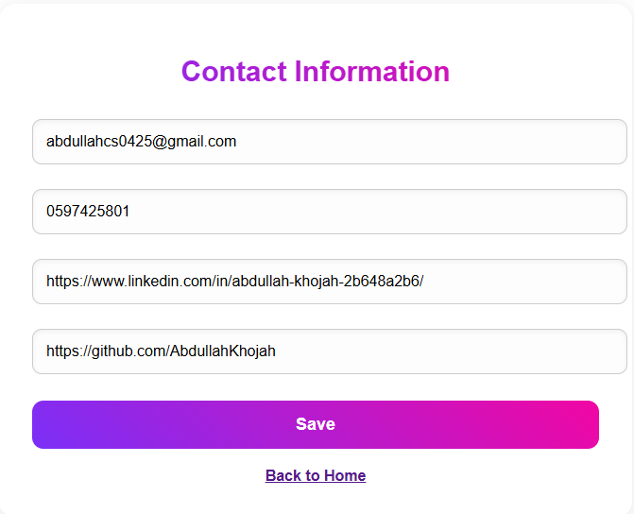
Purpose: Add/Edit contact information.
Description:
User fills in email, phone number, LinkedIn, and GitHub.
Information is shown in the preview page.

Slide 9
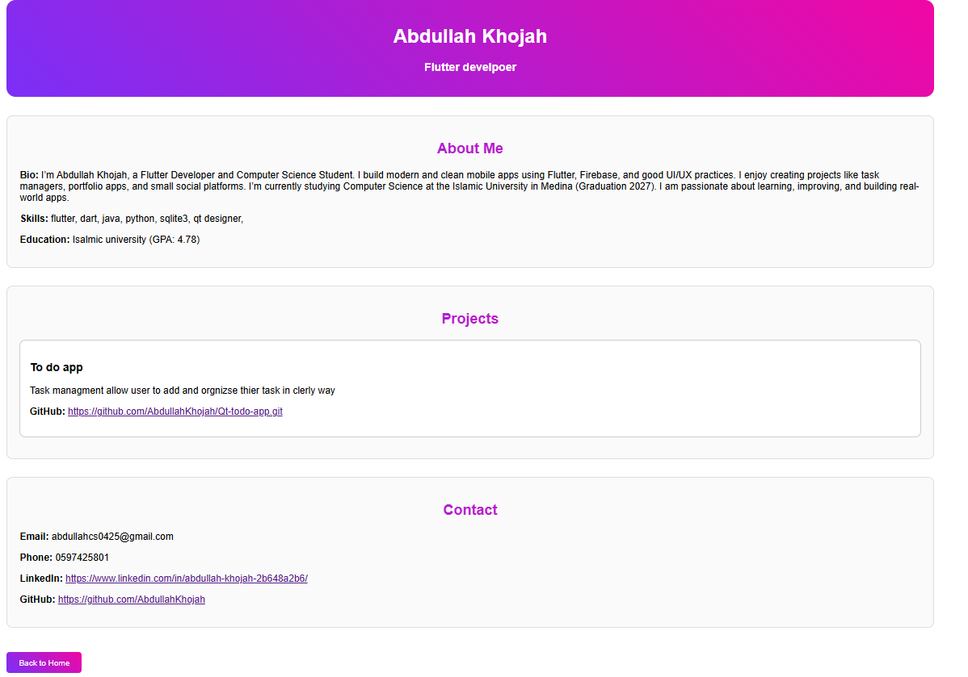
Purpose: Display the final completed portfolio.
Description:
Shows a professional layout including:
About Me section
List of projects
Contact information
The page is fully shareable and linked to the generated QR code.

Slide 10
Thank you for
Listening

